Slide 1
Joins

Slide 2
Outline
Overview
Natural Joins

Slide 3
Intro
Joins are a technique for accessing information across tables.
Conceptually, a join takes the columns from two tables and creates a new virtual table with all of the columns.
This is in contrast to a union, which takes the rows from two tables and forms a new table with all of the rows.

Slide 4
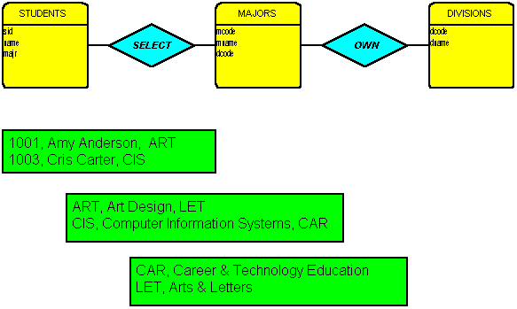
Join ERD

Slide 5
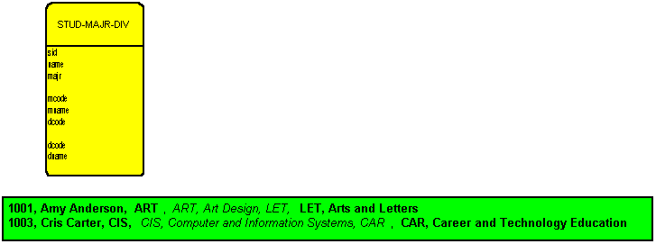
“Joined” ERD

Slide 6
SQL Syntax for Join - Part 1
SELECT column_list
FROM table_list
SELECT sid, name, majr, mcode, mname, dcode, dcode, dname
FROM students, majors, divisions

Slide 7
Problem
How do we get the right columns to line up?
That is, how do we insure that the rows in the students table match up with the right rows in the majors table, match up with the right rows in the division table?

Slide 8
WHERE Clause Technique
Via the WHERE Clause we can specify which rows are to be included/maintained in the result table.
WHERE students.majr = majors.mcode and majors.dcode = divisions.dcode
How does this work?

Slide 9
Cartesian Product₁
Conceptually, the FROM clause creates the Cartesian product, or the cross product, of the two (or more) named tables.

Slide 10
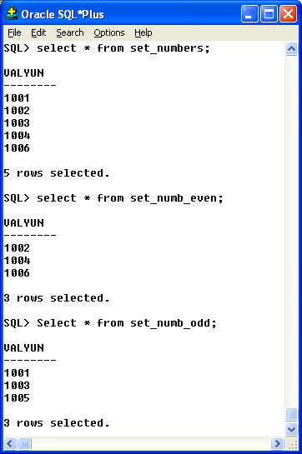
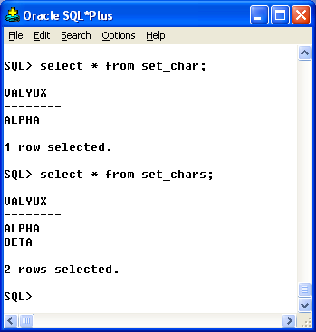
Sample Tables

Slide 11
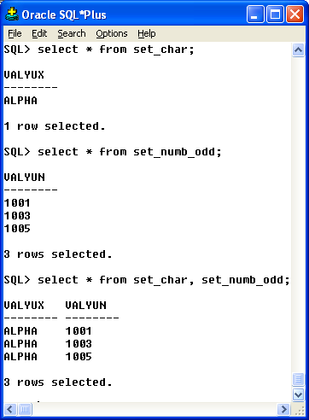
Simple Cartesian Join

Slide 12
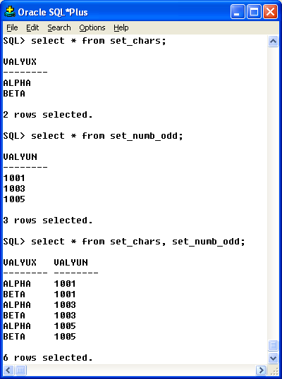
Cartesian Join Example

Slide 13
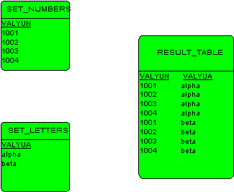
Cartesian Product₁ - Example

Slide 14
Cartesian Product₂
See handout
How many rows will there be in the result table that joins table a and table b if there are 6 rows in each table?
5 and 4
12 and 5
10000 (student rows) 100 (major codes)

Slide 15
Cartesian Product₁
The WHERE Clause then selects which rows are to be maintained in the result table.

Slide 16
Diagram – Conceptual Model

Slide 17
Note
As the diagram / model suggests, joining tables does not effect base tables.
Joining tables does not create base tables.
Joining tables creates working tables or virtual tables that exist only for the duration of the inquiry.

Slide 18
Cross Join
Another name for the cross product or Cartesian product of two tables.

Slide 19
Equi Join
Is a join based on equality, uses the equality operator (=).

Slide 20
Natural Join
A form of the equi join, wherein the duplicated column is not displayed in the result table.

Slide 21
Non-Equi Join
Is a join based on any comparison operator, other than the equality operator.

Slide 22
Theta Join
Any kind of join based on any of the comparison operators.

Slide 23
Inner Join
These examples have all been inner joins. An inner join is bound by a search expression, and disregards any rows where the search condition is not met.

Slide 24
SQL-92 Cross Join
SELECT column_list
FROM table_1 CROSS JOIN table_2

Slide 25

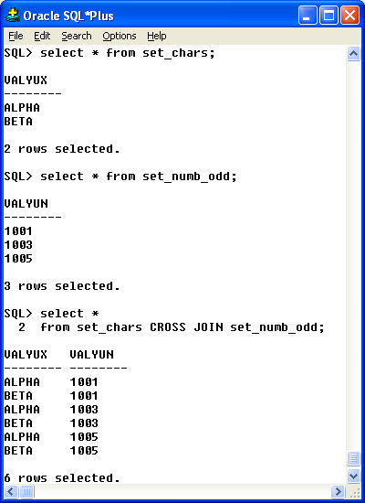
CROSS JOIN

Slide 26
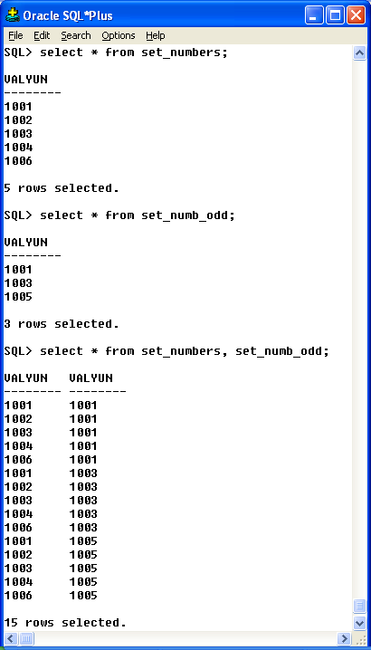
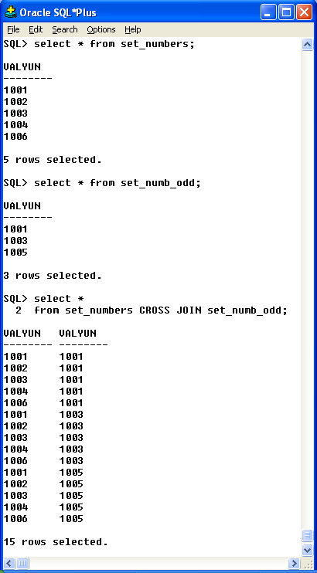

Slide 27
SQL-92 Natural Join
SELECT column_list
FROM table_1 NATURAL JOIN table_2

Slide 28
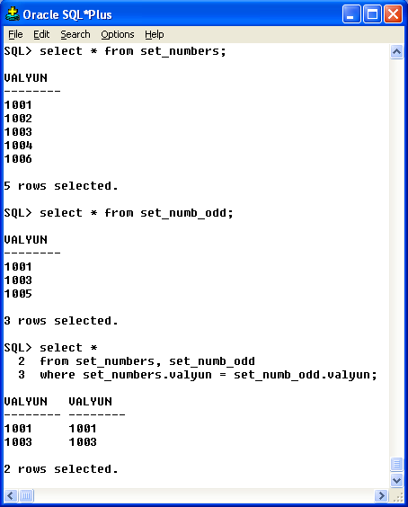
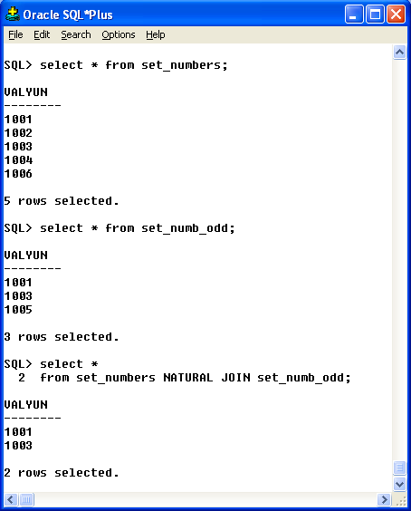

Slide 29
Outer Join
An outer join insures that rows from either one, or both tables are presented in the final result table.

Slide 30
Left Outer Join
Specifies that each row in the first table (as listed in the from clause) will be included in the final result table.

Slide 31
ORACLE
SELECT column_list
FROM table_1 AS t1, table_2 AS t2
WHERE t1.column = t2.column

Slide 32
ORACLE Left Outer Join
SELECT column_list
FROM table_1 AS t1, table_2 AS t2
WHERE t1.column = t2.column(+)
Note the plus sign goes with the table for which null values should be generated

Slide 33
SQL-92 Left Outer Join
SELECT column_list
FROM table_1 LEFT OUTER JOIN table_2

Slide 34
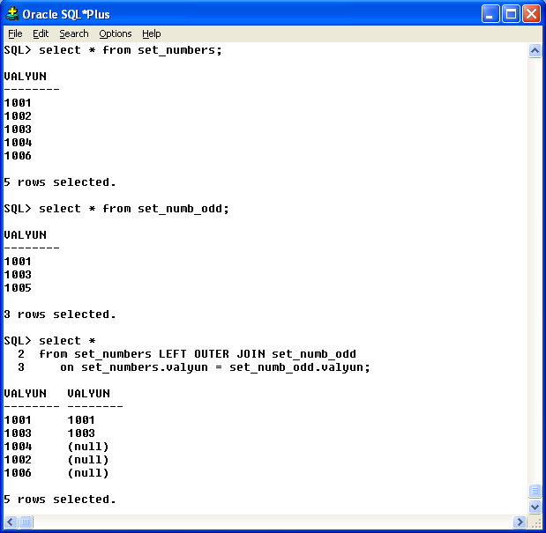
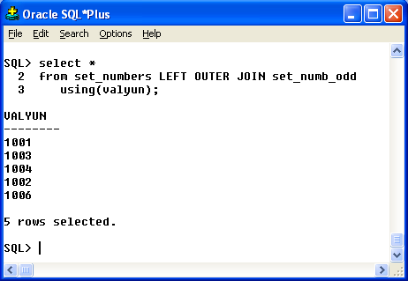

Slide 35
Right Outer Join
Specifies that each row in the second table (as listed in the from clause) will be included in the final result table.

Slide 36
ORACLE Right Outer Join
SELECT column_list
FROM table_1 AS t1, table_2 AS t2
WHERE t1.column(+) = t2.column

Slide 37
SQL-92 Right Outer Join
SELECT column_list
FROM table_1 RIGHT OUTER JOIN table_2

Slide 38
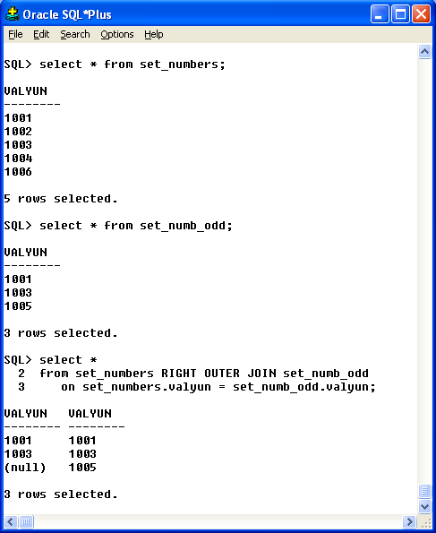
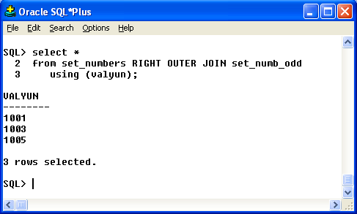

Slide 39
Full Outer Join
Specifies that each row in each table (as mentioned in the from clause) will be included in the final result table.

Slide 40
ORACLE Full Outer Join
SELECT column_list
FROM table_1 AS t1, table_2 AS t2
WHERE t1.column(+) = t2.column(+)
Unfortunately this doesn’t work!

Slide 41
SQL-92 Full Outer Join
SELECT column_list
FROM table_1 FULL OUTER JOIN table_2

Slide 42
Terminology
Cartesian product
Cross join
Equi join
Non-equi join
Natural join
Inner join
Outer join
Left (outer) join
Right (outer) join
Full (outer) join

Slide 43
Questions / Comments

